Slide 1
HOOKSHOT
By team: Hook
Producer - Egi
Lead Designer - Liu ke
Technical Director - Wei Wen
Testing Manager - Yong Hui

Slide 2
Overview
USP: With hookshot mechanic. Point and Click. Able to hook & cause damage.
Genre: Adventure, Cave Exploration, 2D Side Scroller
Art Style: Pixel
Level Based System - Non linear [Min: 3 | Max: 7]
End Goal: Get the Ultimate Artifact.
--------------------------------------------------------
#1 Stretch Goal - Puzzles Platforming
#2 Stretch Goal - Time attack
#3 Stretch Goal - Upgrades to access new areas & become stronger
Notes:
We will need to decide if we have enough time to create an upgrade system after finish up the physics and mechanics -> before creating the levels.
Here is a simple overview of our game, It is a hookshot mechanic. Where the player mainly point and click with the mouse.
Using the hook to attack and swing.
Overall it is an adventurer base game, where the player explore a cave to reach the end goal to get find the ultimate artifact.
Here are some of our stretch goals:
puzzle platforming, a time attack, upgrade system.
note no need to say simple phyisic game
your flow liu ke,i think ya write a small script first T_T

Slide 3
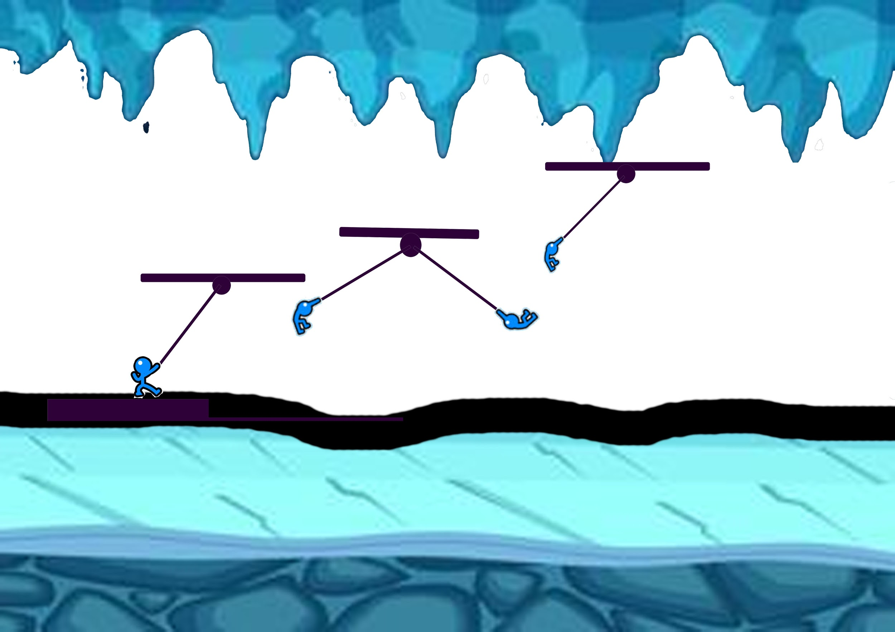

Design setting and stories
The story goes by Mr hook ( player ) and his dinosaur buddy, Rex trying to uncover a secret artifact said to lie in the heart of an ancient cave.
However, Mr hook’s was separated from Rex before their adventure can begin. Now Mr hook have to not only uncover the treasure but also find his way back out.

Slide 4

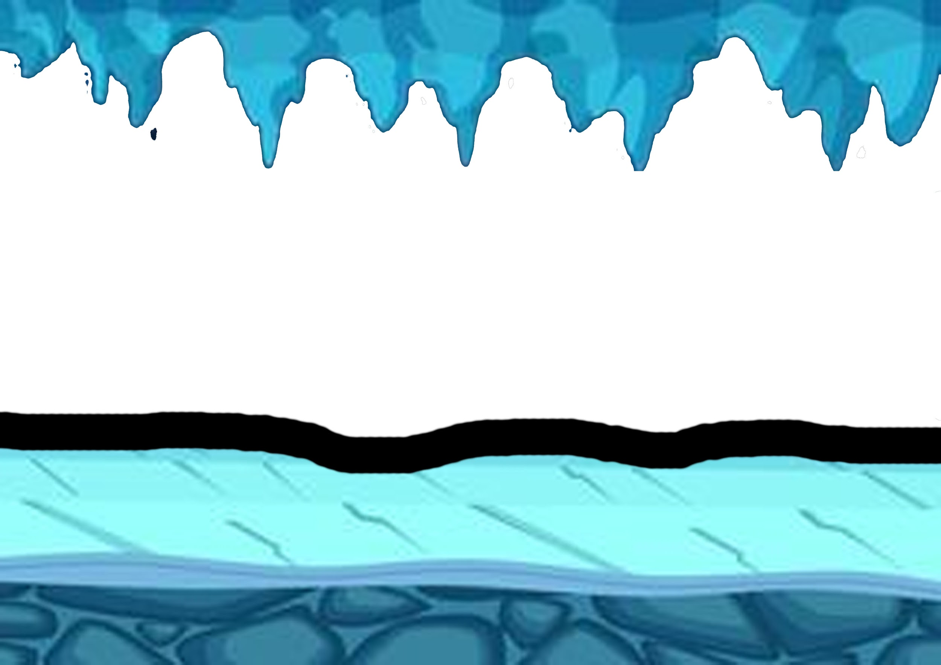
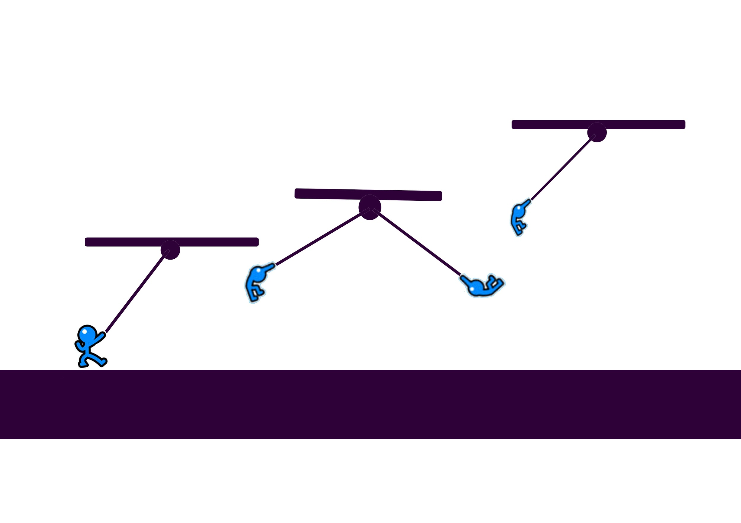
Conceptual ideas / designs
Style
Settings
Mechanics
A concept Art of the style we will be using In the game.
We hope to achieve an adventurous whimsical feel to the game
Majority of the setting will be inside a cave system where the player will have to navigate through while fighting cave dwelling enemies along the way
The main feature will be hook, where the player will be able to grapple to almost any wall to swing over huge gap or to knock an enemy back
Notes:
the style we hoped to achieve is an pixelated adventuorus whinmisal feel/

Slide 5
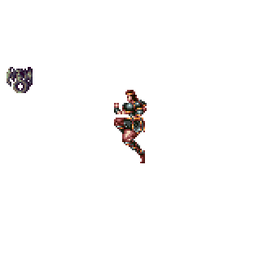
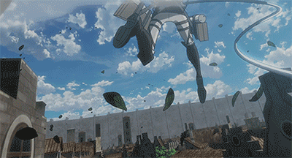
User Selling point
The core mechanic of the game: Hook shot.
Character can Anchor to the wall and swing over obstacles that normal jumps cannot overcome.
It may be possible to chain such Maneuver together. This is useful for speedruns
The hook shot have 2 ways of eliminating the enemy:
Hp Reduction (unseen health bar)
Knocking them off platform
Possibility of an upgrade system for the hookshot.
Notes:
possibility of an upgrade system -> as mentioned in our stretch goals

Slide 6
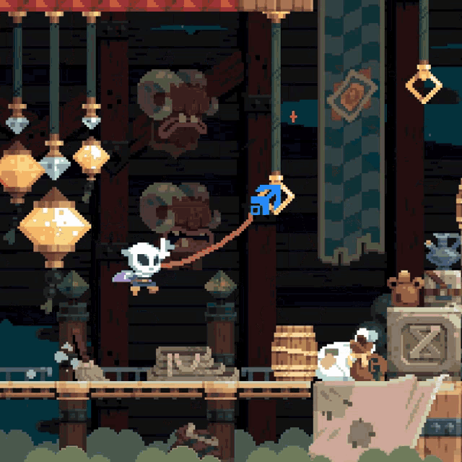
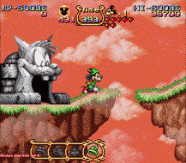
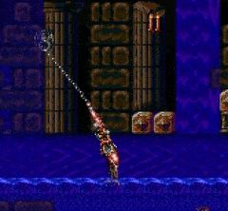
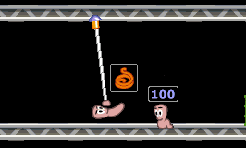
Existing examples
Flint Hook
Mickey mouse magical quest 2
Castlevania 4
Worm Warfare

Slide 7
Feasibility
?
Plan. Risk. Mitigation

Slide 8
SWOT Analysis
Strength Unique gameplay Twist on the traditional 2D platformer Uncommon Mechanic | Weakness High technical knowledge Potentially over reliant on Hookshot mechanic Needs to be well implemented
Opportunities Able to stand out in the market | Threats Low references Not a proven to work game. Not explored widely

Slide 9
Solution to weakness & threats
Over reliant on USP
Low references
High technical knowledge required
Start early
Don’t be afraid to request for help
More diverse levels
Open mindedness
Traditional 2D Platformer
More User Testing
Notes:
High Technical Knowledge
Start early, more time to practice and figure things out
Ask for help if we need it
Over reliant
Create more diverse levels to change up the gameplay
Being open minded to possible changes, if the USP is not fun
As a traditional 2D platformer, it is still relatively safe.
Low References
We can do more User Testing to help fine tuning the mechanics to make it fun and enjoyable

Slide 10
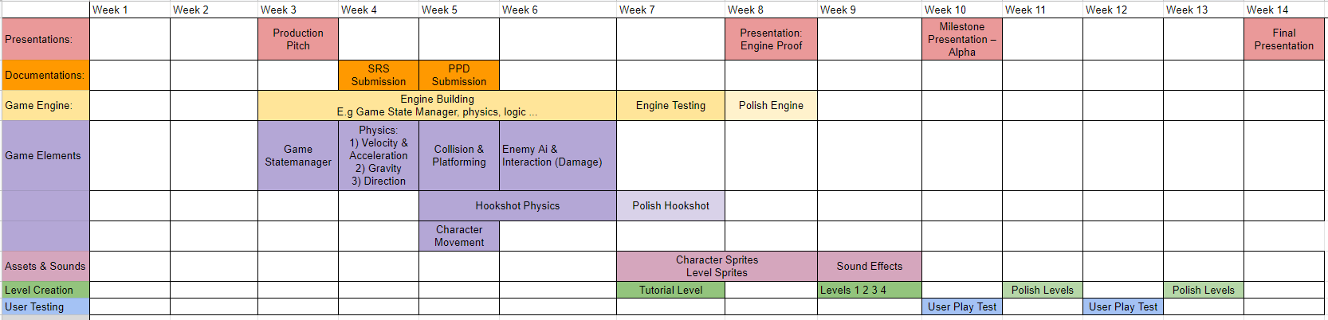
Delivery Plan
Wk 6 - Done with engine building
Wk 8 - Full workable tutorial level with basic gameplay
Wk 9 - Onwards:
Adding of other levels
Stretch Goals
Wk 13 - Finalised Build
Notes:
By Week 6 -> Complete the engine, gives us about 2 weeks to polish and test it.
Week 9 Onwards -> Add in the other levels and any stretch goals if we have the time. So that on week 10 we can present a proper alpha build, not just the tutorial. .
After the presentation we will then focus on more polishing, and stretch goals
Week 13 -> The final build will have to be completed.

Slide 11
Thank You!
By team: Hook
Producer - Egi
Lead Designer - Liu ke
Technical Director - Wei Wen
Testing Manager - Yong Hui
Questions ?

